Slide 1



Special Educational Needs and Disabilities (SEND)
School Information Report for parents/carers
Scotch Orchard Primary School
Last updated October 2024

Slide 2
What are our values and aims?
At Scotch Orchard Primary School we believe that every child is unique and should be valued as an individual. Some of our children may need more support to access school life and there are a number of ways that we try to achieve this. As we are proud members of The Arthur Terry Learning Partnership, we share our ethos and values within the Trust. More information can be found at Purpose and Vision – The Arthur Terry Learning Partnership (atlp.org.uk)
Our school information report aims to support parents in understanding how we meet the needs of our children with Special educational needs and disabilities also referred to as SEND or SEN. This forms part of Staffordshire’s local offer which can be found at Staffordshire Connects
Our school special needs co-ordinator is Mrs Michelle Spires. Her role is to oversee provision for our children with additional needs.
She can be contacted via the school office, or email senco@scotchorchard.staffs.sch.uk

Slide 3
How do we identify if a child has Special Educational needs
At different times in their school life, a child or young person may have a special educational need. The Code of Practice 2015 defines SEND as follows:
“A child or young person has SEN if they have a learning difficulty or disability which calls for special education provision to be made for him or her. A child of compulsory school age or a young person has a learning difficulty or disability if he or she:
a) Has a significantly greater difficulty in learning that the majority of others the same age, or
b) Has a disability which prevents or hinders him or her from making use of facilities of a kind generally
provided for others of the same age in mainstream schools or mainstream post-16 institutions.
Where pupils’ progress is significantly slower than that of their peers, or fails to match their previous rate of progress, despite high quality teaching targeted at specific areas of difficulty, it may be that the child has SEN. Information will be gathered, including seeking the views of parents and the pupil, as well as from teachers and assessments.
Concerns may also be raised through:
Liaison with Infant school/previous school or nursery setting
Discussions raised by parents/carers
Liaison with external agencies eg for a physical/medical need
A health diagnosis through their paediatrician or other health care professional
There can be many reasons for learners not making expected progress. These may include absences, attending different schools, difficulties with speaking English, or worries that distract them from learning. The school understands that children who experience these barriers to learning are vulnerable and may need extra support to help them achieve. This does not mean that all vulnerable learners have SEND. Only those with a difficulty that requires special educational provision will be identified as having SEND.

Slide 4
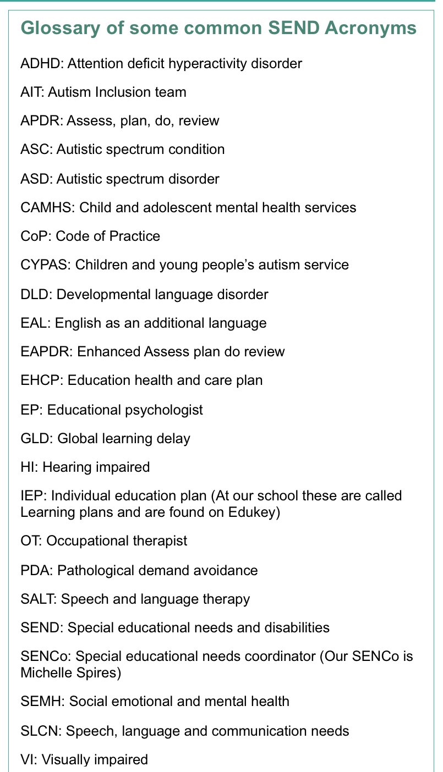

Slide 5
What should I do if I think my child may have special educational needs?
At Scotch Orchard Primary School, we pride ourselves on building positive relationships with parents and carers. We encourage an open and honest relationship whereby we can develop quality support for your child.
If you would like to raise a concern, please either discuss your concern with your child’s class teacher in the first instance. A meeting may then be arranged with a member of the leadership team or with the school SENCo if necessary.

Slide 6
What happens if it is considered that my child may have special educational needs?
As soon as any concern is raised about a child, parents/carers will be contacted to discuss this. We then follow the graduated approach and the assess, plan, do, review model as stated in the Code of practice 2015.
This can be found at https://www.gov.uk/government/publications/send-code-of-practice-0-to-25
Once a concern has been raised and are parents informed, the class teacher and SENDCo monitor the pupil carefully and ensure that quality first teaching strategies are in place. Interventions and classroom provision is tailored to meet the pupil’s needs.
If concerns continue the child will be placed on the SEND register and, if needed, specialist agencies may be involved and further interventions and support will be put into place. The class teacher will record this on a personalised SEN plan using a platform called Edukey. You will be given parental access to this by your child’s class teacher.
Where a child requires additional support that goes beyond what the school, or nursery can typically deliver from their own budgets or staffing then we may need to apply for additional support or, an Education, Health and Care Plan (EHCP) – An EHC plan is a legally binding document outlining a child or Young Person’s Special educational, health, and social care needs.

Slide 7
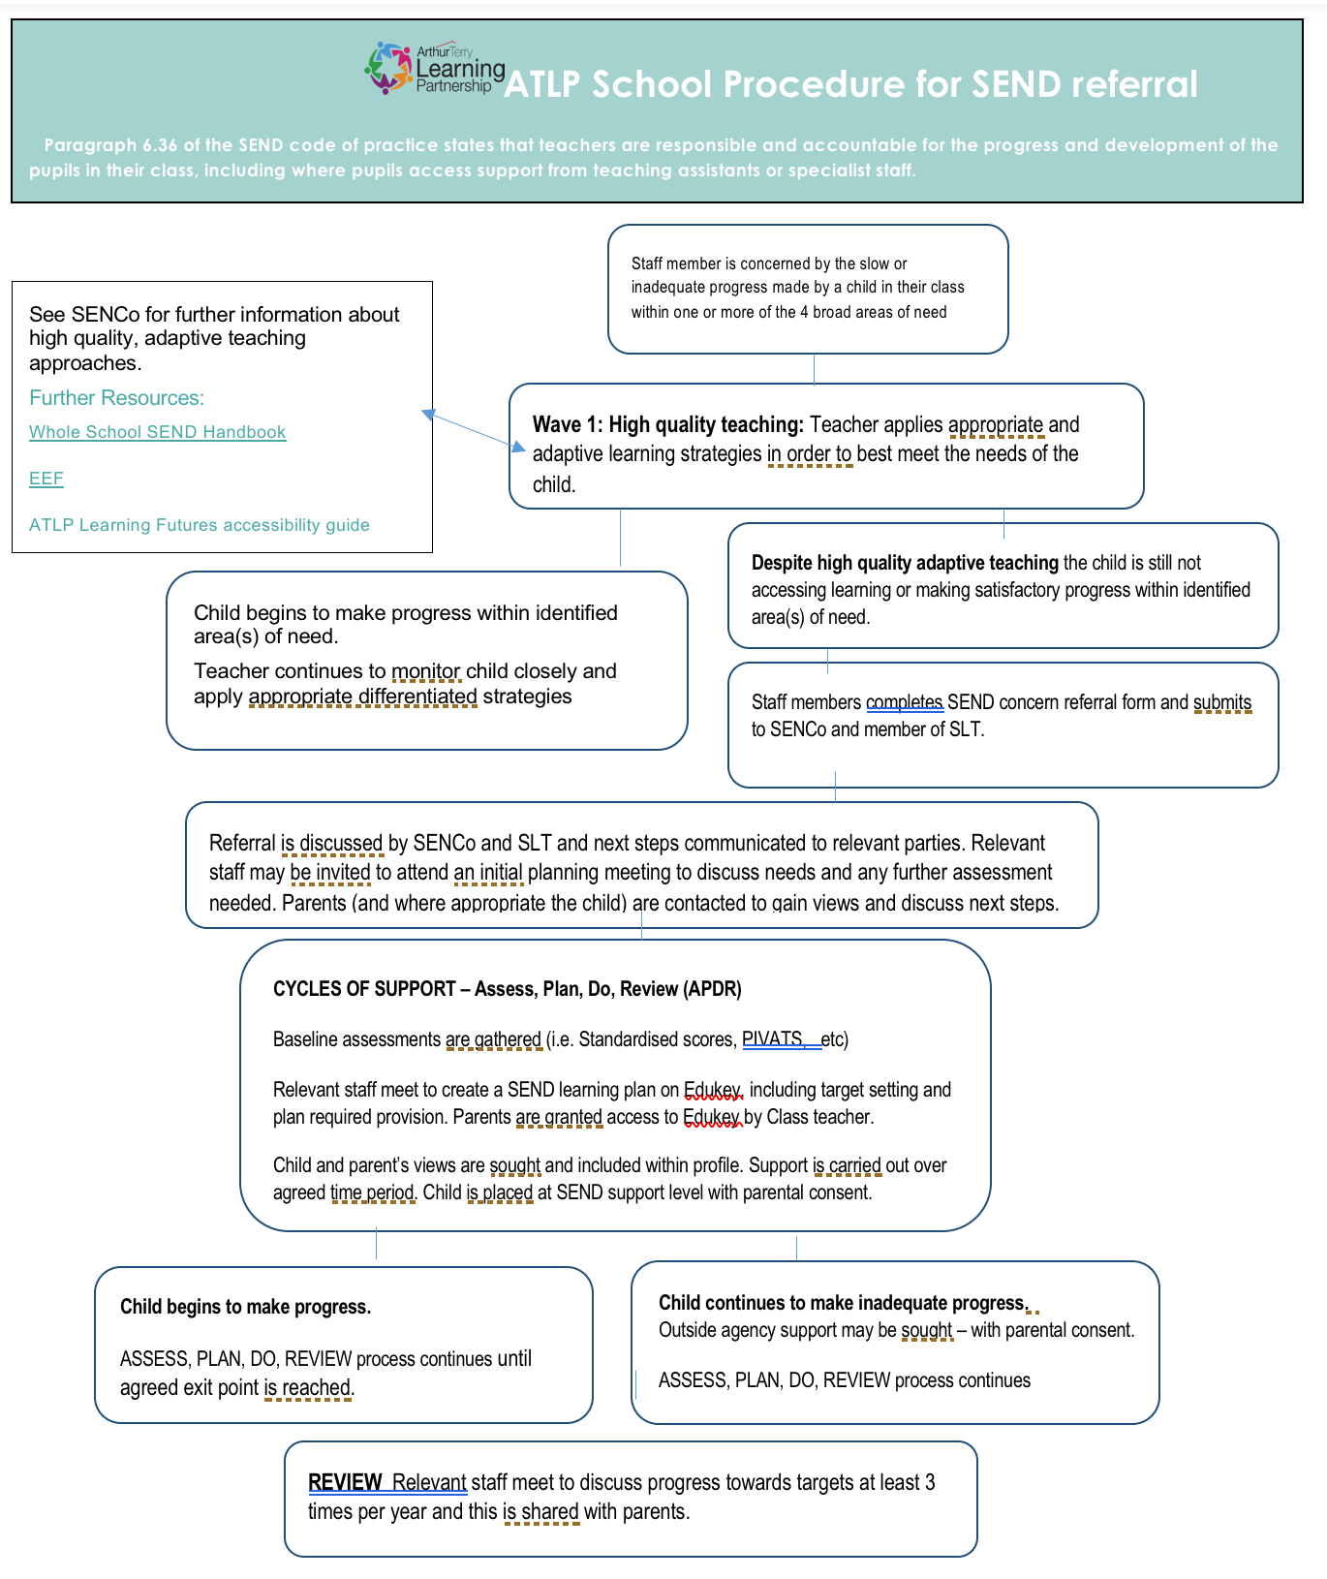
What happens if it is considered that my child may have special educational needs?
At Scotch Orchard we take a graduated response to the individual needs of our children.
SEN support has a clear cycle of assessment of progress, planning and putting in place the appropriate support, and reviewing a child or young person's progress. This is known as 'Assess, Plan, Do, Review'.

Slide 8
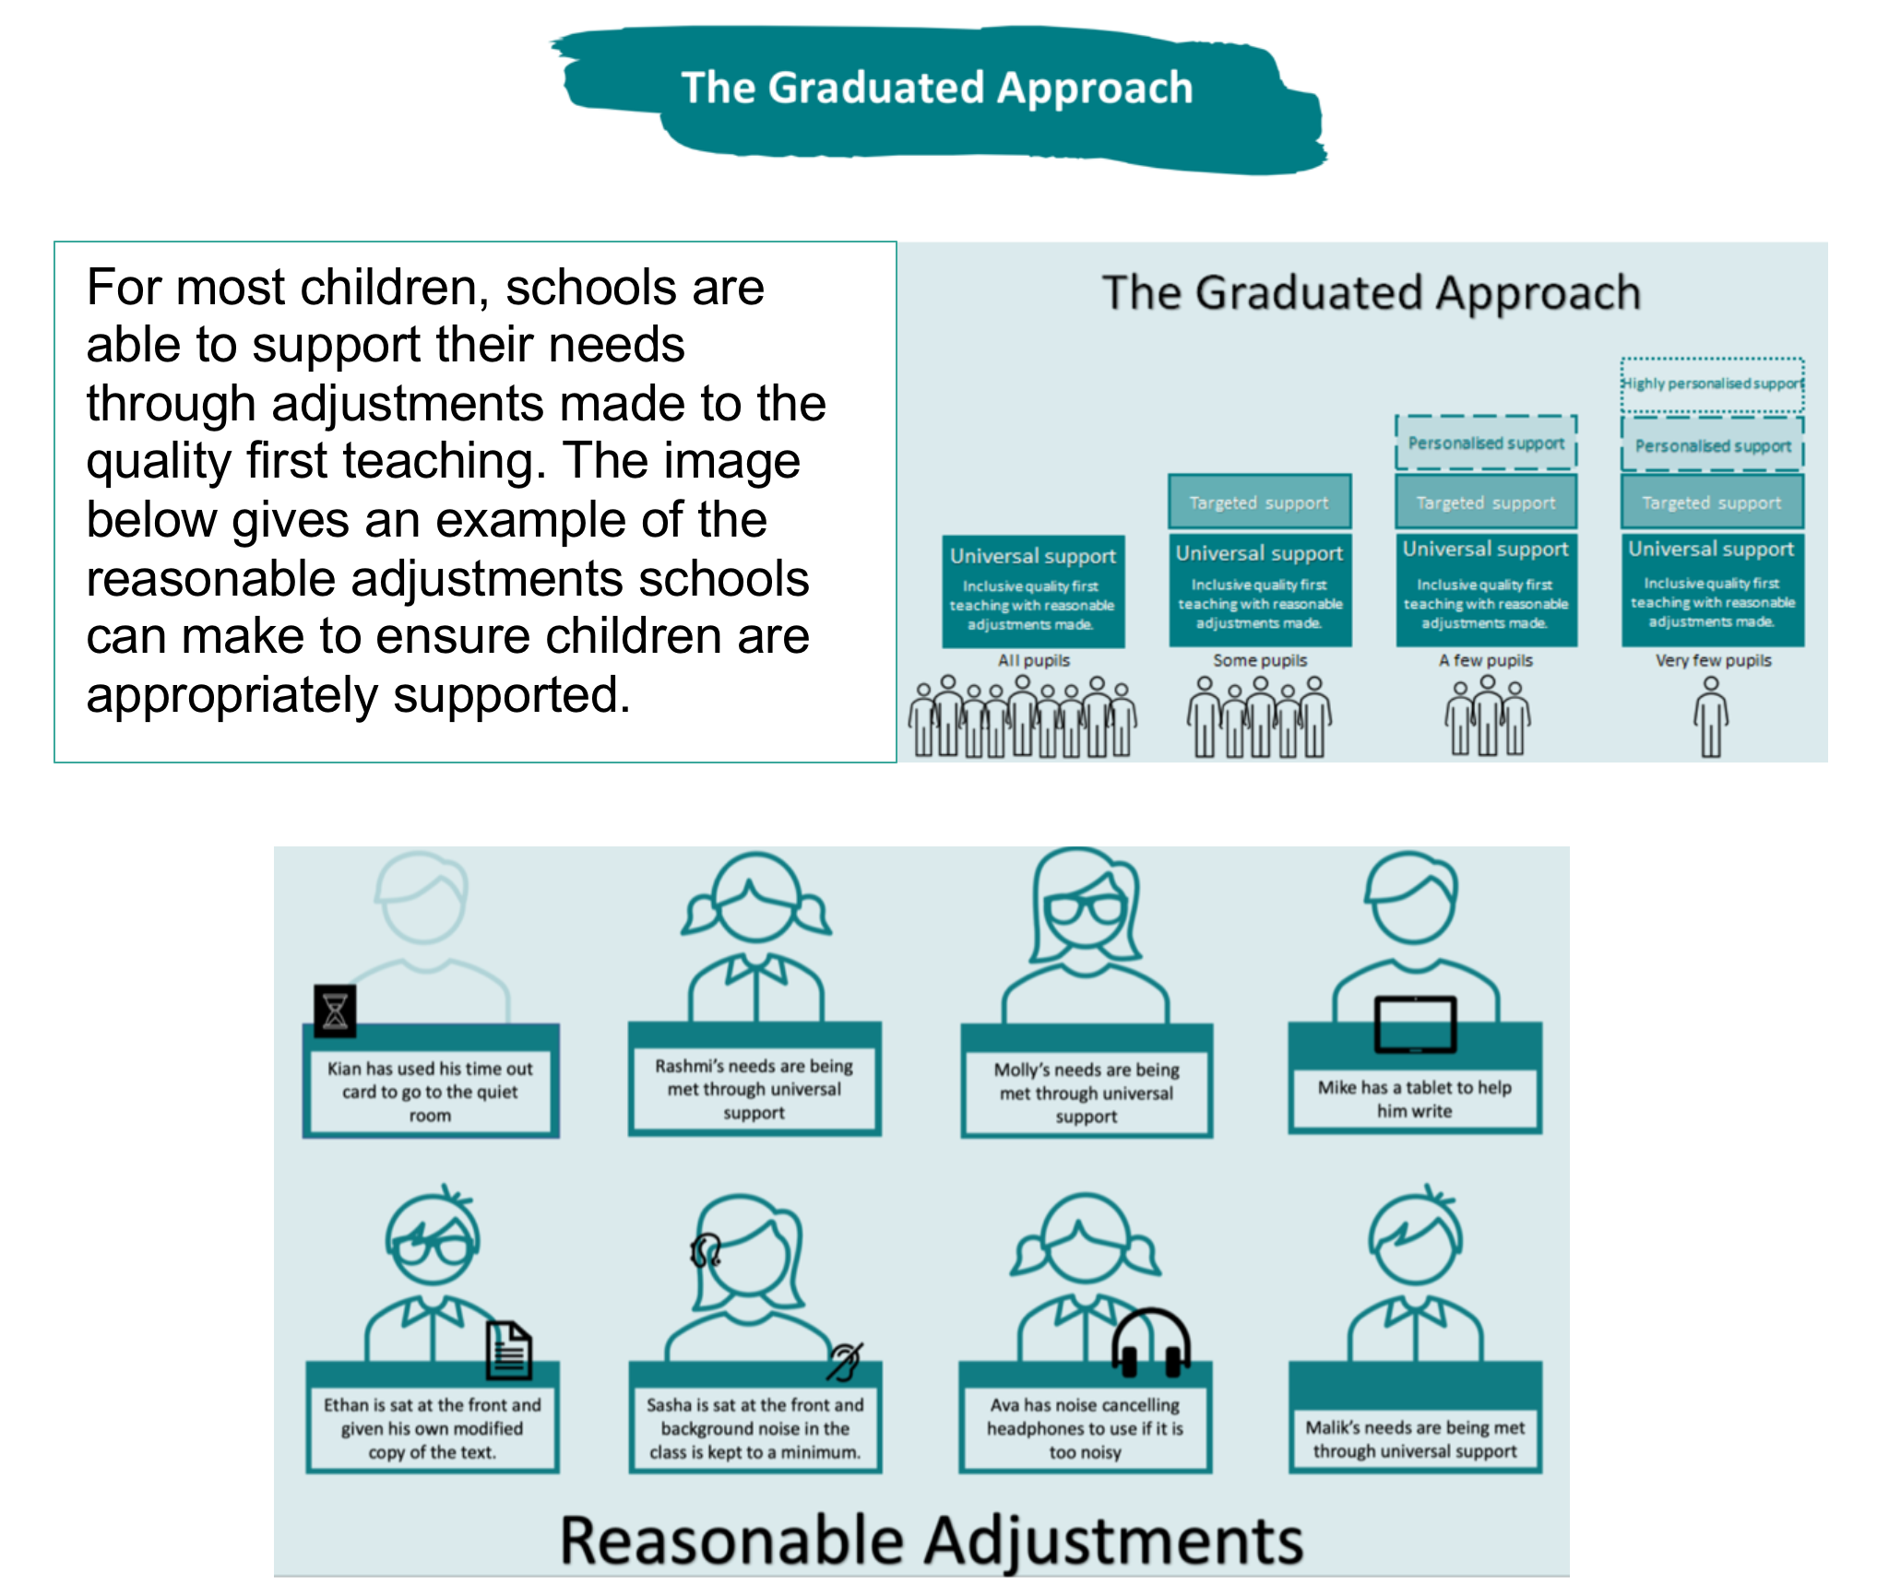

Slide 9
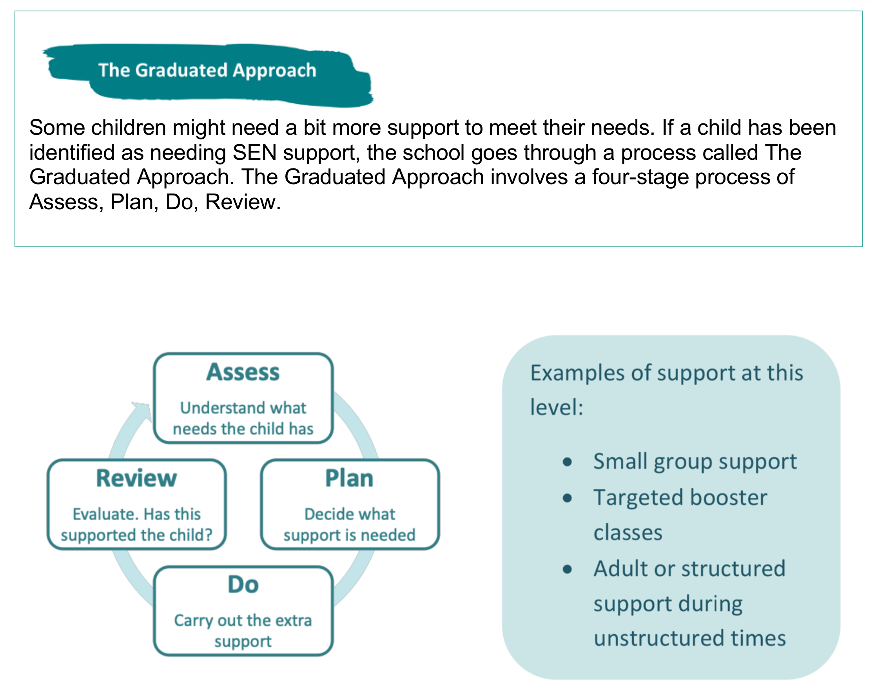

Slide 10
Assess – This involves clearly analysing the child’s needs using the class teacher’s assessment and experience of working with the child, details of previous progress and attainment, comparisons with peers and national data, as well as the views and experience of parents and the child.
Plan – This stage identifies the barriers to learning, planning will involve consultation between the teacher, SENCO and parents to agree the adjustments, interventions and support that are required; the impact on progress, development and or behaviour that is expected.
Parental involvement may be sought, where appropriate, to reinforce or contribute to progress at home. All those working with the child, including support staff will be informed of their individual needs, the support that is being provided, any particular teaching strategies/approaches that are being employed and the outcomes that are being sought.
These plans will be recorded by the class teacher using the online platform – Edukey, which parents will also have access to.

Slide 11
Do – The class teacher remains responsible for working with the child on a day-to- day basis. They will retain responsibility even where the interventions may involve group or one-to-one teaching with other staff. The teacher will plan and assess the impact of support and interventions and ensure it links with classroom teaching. Support with further assessment of the pupil’s strengths and weaknesses, problem solving and advising of the implementation of effective support will be supported by the SENCO.
Review – Reviews of a child’s progress will be made at least termly. The review process will evaluate the impact and quality of the support and interventions. It will also take account of the views of the pupil and where necessary their parents. The class teacher will revise the support and outcomes based on the child’s progress and development making any necessary amendments going forward. Reviews will be recorded on the child’s SEN learning plan on the platform Edukey.

Slide 12
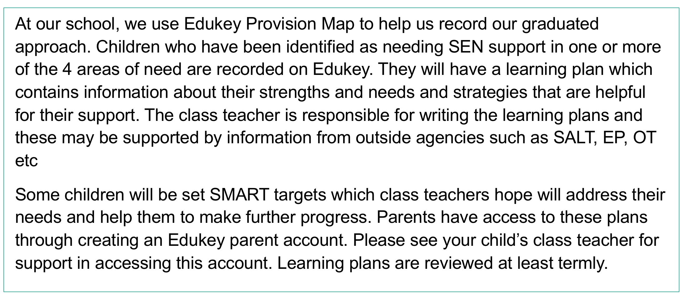

You can access Provision Map by clicking here.

Slide 13
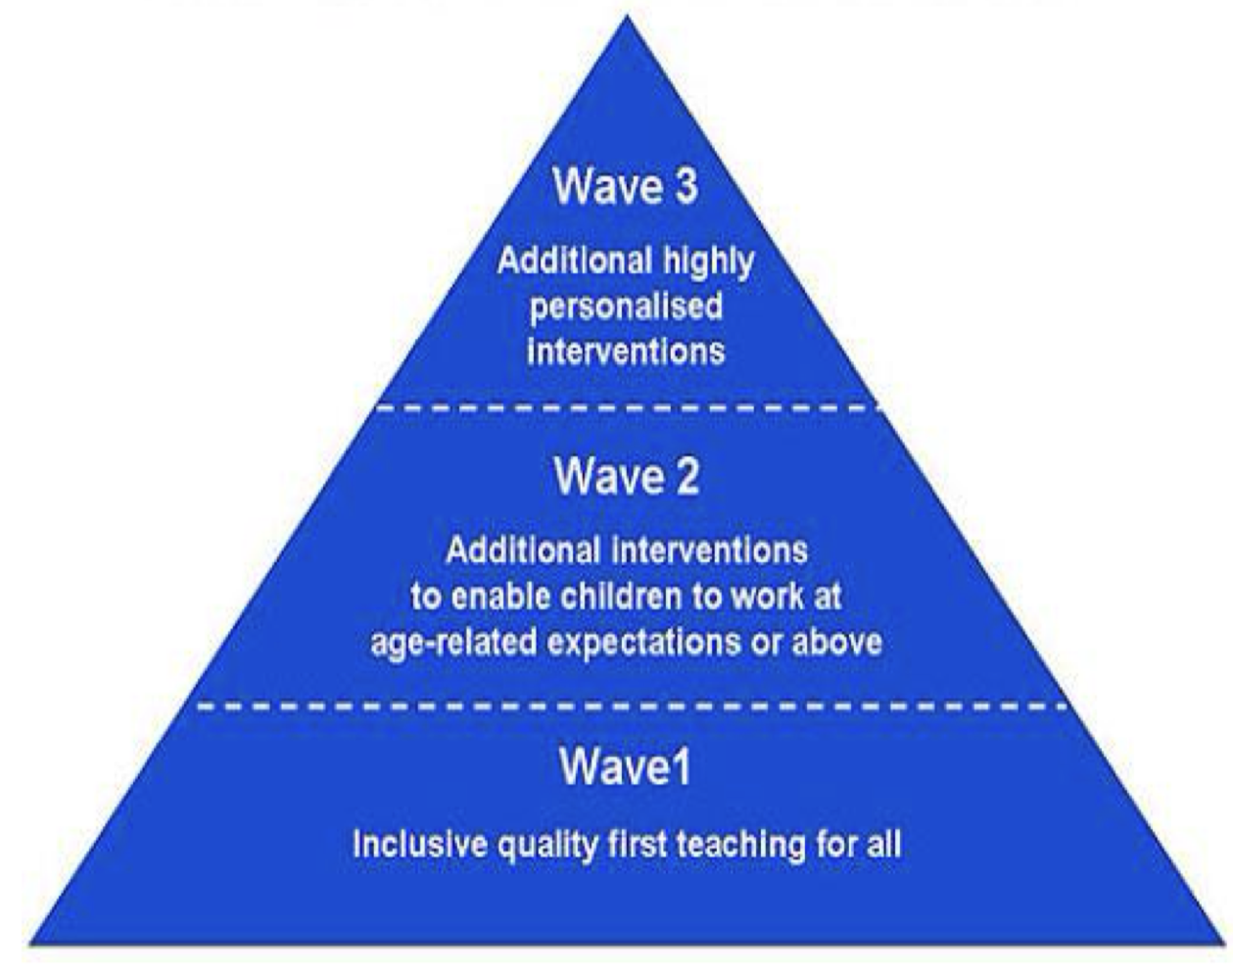
How will school support my child?
Support may be universal, targeted or specialist depending on the need of the child . The class teacher will oversee, plan and work with each child with SEND in their class to ensure that progress is made.
Universal provision-Universal provision in schools and settings is what is in place for all pupils to enable them to make expected progress.
Targeted provision-Targeted support is additional, time-limited, tailored intervention support programmes. Targeted support can be for any area of difficulty, including literacy, numeracy and behaviour. Pupils receiving targeted support do not necessarily have SEND. Universal support remains in place.
Specialist provision- Specialist support refers to increasingly individualised SEND programmes.
When additional equipment or support is needed this is looked at on an individual basis and matched to the needs of the children.
All pupils will be provided with high quality teaching that is adapted to meet the needs of all learners.

Slide 14
Which type of needs does the school support?
The SEND Code of Practice categorises SEND into four broad areas of need – children may have difficulties in one area, or may have a range of needs (sometime called complex needs).
The four areas are:
Cognition and learning
How children learn and think.
Communication and interaction
How children communicate with others, their relationships and social skills.
Sensory and/or physical needs
Sensory issues include hearing and visual impairments (or sometimes both), Physical problems include physical disabilities, and motor skills difficulties.
Social, emotional and mental health (SEMH)
SEMH covers a range of problems, including mental health difficulties, ADHD or social anxiety, confidence or self-esteem issues.

Slide 15
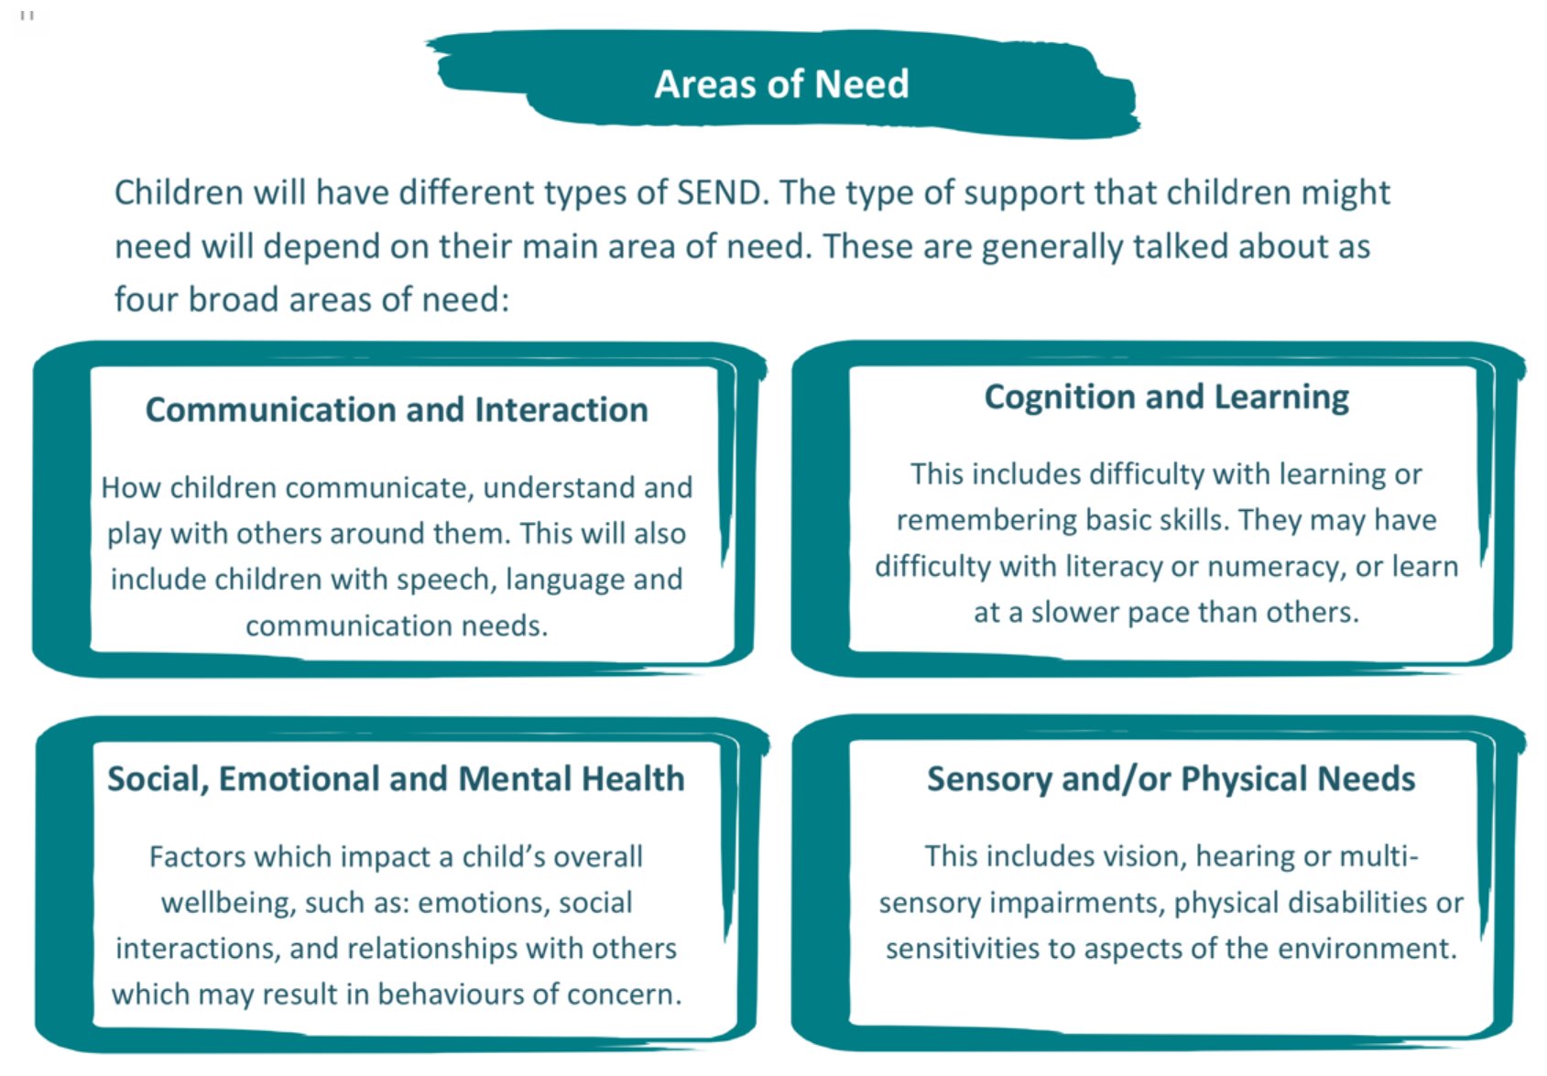

Slide 16
How does the school support Cognition and learning needs?
Below are some examples of the types of support available. This list is not exhaustive and at Wave 3 guided by outside agency advice.
Wave 1 – Universal | Wave 2 – targeted | Wave 3 – Specialist
High aspirations and expectations for all learners Building upon previous learning to enable learners to remember long term content Modelling- I do, we do, you do, Working walls Alphabet strips, Phoneme mats, Key word mats Chunk instructions and information Check understanding e.g. Learners to repeat back instructions Visual cues Processing time A variety of recording methods Scaffolding e.g. Writing frames Manipulatives/concrete resources Visual timetables/ timetables Dual coding e.g. diagrams and pictures to add meaning Minimise copying from the board Reduce distractions | Individual workstation Allow additional time to complete tasks Alternative options of recording Small group pre-teaching vocabulary or skill Small group post-teaching to embed class teaching Interventions for specific skills e.g., ➢ Phonics ➢ Reading/writing/maths ➢ Precision teaching/ EPS literacy approach to reading / spelling ➢Nessy Programme – typing, reading, spelling and maths Colourful semantics Coloured overlays/paper Speak to text software/Ipad Read aloud software/Ipad Adapted home learning tasks Chunking Movement Breaks Now and next Timers Task boards Strategies to support identified neurodivergent needs such as Autism, ADHD. | Support from Educational psychology Personalised learning aims Personalised curriculum

Slide 17
How does the school support communication and interaction needs?
Below are some examples of the types of support available. This list is not exhaustive and at Wave 3 guided by outside agency advice.
Wave 1 – Universal | Wave 2 – targeted | Wave 3 – Specialist
High aspirations and expectations for all learners Pitched questioning Modelling of skills Modelling of speech/language Talking partners Whole class circle time Visual timetables Keywords/banks Additional processing time Simplified language Pairing visuals with words Objects of reference | Strategies to support identified neurodivergent needs such as Autism, ADHD and difficulties such as DLD Wellcomm assessment and intervention Pre / post teaching vocabulary Task boards Speech sound assessment and intervention Individual workstation Personalised visuals e.g. visual timetable, toilet card etc. Specific strategies/ resources: ➢ Comic strip conversations ➢ Social stories ➢ Emotion scales (how my engine runs, zones of regulation, incredible 5 point scale) | Support from Educational psychology Support from Speech and Language services Support from Autism inclusion team Targeted work from speech and language therapy services i.e colourful semantics, PECs

Slide 18
How does the school support Sensory and Physical needs?
Below are some examples of the types of support available. This list is not exhaustive and at Wave 3 guided by outside agency advice.
Wave 1 – Universal | Wave 2 – targeted | Wave 3 – Specialist
High aspirations and expectations for all learners Designing learning environments to support access to learning i.e. consideration of lighting, acoustics, layout etc Specific early years teaching involving fine and gross motor skills development. Modelling of key skills Text presented clearly (font size, font type, background) Use of assistive technology i.e. apps / assistive tech on ipad | Pencil grips Writing slopes Flexibility of uniform policy Organisation of classroom Direct view of teacher Fine motor groups Handwriting groups Sensory circuit groups | Support from Educational psychology Support from Speech and Language services Support from Autism inclusion team Support from Occupational therapy service Personalised intervention as guided by the above services Use of specialist equipment

Slide 19
How does the school support Social, emotional and mental health needs?
Below are some examples of the types of support available. This list is not exhaustive and at Wave 3 guided by outside agency advice.
Wave 1 – Universal | Wave 2 – targeted | Wave 3 – Specialist
High aspirations and expectations for all learners My Happy Mind Curriculum PSHE curriculum teaching Clear behaviour expectations Relational approach Growth Mindset Listen to the child or young person Identify strengths and interests Cue in by name Calming music when appropriate Kinaesthetic learning opportunities Positive language and unconditional positive regard Clear time limits for work Consideration of seating arrangements (for e.g. for attention, focus, good role models) Transitions considered Communicate in a calm, clear manner Keep instructions, routines and rules short, precise and positive | Strategies to support identified neurodivergent needs such as Autism, ADHD. ELSA/nurture/cherished group support Signposting to local services such as Sand box. Brain/movement breaks Wobble cushions Chair bands Fidget resources Access to calm spaces Movement breaks Sensory circuits Restorative practices Emotion check ins Emotion visuals/cards to indicate how child is feeling | Support from Educational psychology Action for children CAMHS Community Paediatrics Family support services

Slide 20
How will the curriculum be matched to my child’s needs?
Our curriculum is designed to be inclusive and to allow all learners to engage in all activities. We aim to give children a range of learning opportunities and styles so that they can find the areas that they can excel in.
All work within class is pitched at an appropriate level so that all children are able to access according to their specific needs. This may be in the form of differentiated activities, extra resources, pre-teaching, extra modelling and scaffolding. Some children may require more personalised curriculums which will be agreed with the SENDCo, parents/carers, teachers and, if required, outside agencies.
We make reasonable adjustments for all pupils, including disabled pupils to ensure that children with SEND are able to access all aspects of school life. We do this by planning and risk accessing any curriculum and non curriculum activities to ensure they are accessible to all and adjustments are made when needed. Our accessibility policy is available on our school website.
Our admission policy is based on upon the agreed Staffordshire County Council admissions policy.
Normal admission arrangements will be followed for pupils with SEND.
When children with disabilities join our school we work closely with parents/carers and any professionals involved to ensure disabled pupils can access our school.

Slide 21
How do we adapt the curriculum and learning environment to meet the needs of our children with SEND?
We make the following adaptations to ensure all our pupils’ needs are met:
Adapting our curriculum to ensure all pupils have access to it, by grouping, 1:1 work, teaching style, adapting content of the lesson.
Adapting our resources and staffing.
Using recommended aids, such as laptops, assistive technology, larger font, coloured overlays, practical resources etc.
Adaptive teaching, for example giving longer processing times, pre-teaching of key vocabulary, reading instructions outload etc
Following advice from outside agencies and specialists.

Slide 22
How will I know how my child is doing and how will you help me to support my child’s learning?
We offer an open door policy where you are welcome any time to make an appointment to meet either the class teacher, SENDCo or senior leadership team and discuss how your child is getting on. We can also offer advice and practical ways you can help your child at home.
We believe that your child’s education should be a partnership between home and school, therefore we aim to keep communication channels open and communicate regularly, especially if your child has complex needs.
If your child is on our SEND register, they will have a Learning Plan which will outline individual pupil information and learning targets.
You will be invited in to school on a termly basis for a pupil centred review meeting where we will discuss the needs and progress of your child. These meetings ensure that everyone develops a good understanding of the pupil’s areas of strength and difficulty, parents/carers concerns are taken into account and that everyone understands the agreed outcomes and next steps for the pupil.
Any reports from outside agencies will be sent home and you will be invited into school to discuss these reports. If working with outside agencies, meetings with the professionals may take place with school and parents to ensure a collaborative approach.

Slide 23
How does the school know how well my child is doing?
As a school, we measure children’s progress in learning against The National Curriculum expectations and age related expectations.
The class teacher continually assesses each child and notes areas where they are improving and where further support is needed.
Children who are not making expected progress are identified through pupil progress meetings with the class teacher, Deputy /Head teacher/ Phase leader / SENDCo. In this meeting a discussion takes place concerning which children are experiencing difficulty and what further support can be put in place. If your child is discussed at one of these meetings, you will be informed.
When the child’s Learning Plan is reviewed, comments are made against each target to show the progress the child has made and are shared with parents/carers.

Slide 24
What support will there be for my child’s overall well being?
We are very proud of the pastoral support we provide for all the pupils and families at our school.
We have the support of a school family support worker: Mrs C Rowley
We have the support of a School learning mentor: Mrs L Savage
We have a dedicated and highly skilled team at ATLP ready to help and encourage pupils and families who wish to discuss any problems or request extra support. This can range from friendship issues, attendance, family breakdowns, bereavements or any emotional difficulties that arise during the course of the year.
Our vision is to ensure that all children feel safe and happy in our school and to help them overcome any barriers to learning they may have. We are here to ensure all children receive their potential and are prepared for life.

Slide 25
How will my child be able to contribute their views?
At Scotch Orchard Primary school, we value and celebrate each child being able to express their views on all aspects of school life. During each review cycle, children have the opportunity to share their views and interests which are incorporated into the single page profile of their Learning Plan. Where appropriate, targets are also shared and discussed with pupils.
Children are encouraged to self assess and share their views during lessons and interventions.
Where appropriate children will be invited to attend their EHCP review meetings.
Where possible, meetings will take a person centred approach.

Slide 26
What specialist services and expertise are available at or accessed by the school?
Michelle Spires is a fully qualified teacher who has taught in a range of schools and across local authorities since 2008. She holds the National SEND Qualification Award and has been in the role of SENDCo since 2012. Michelle Spires is non class based and leads SEND within the Lichfield Hub of ATLP Schools.
All our teachers and support staff are given regular training throughout the year. Any new staff are given a full induction and SEND training.
We have a team of dedicated teaching assistants with many years experience. All TAs have at least a Level 2 qualification.
Where needed, we work with a range of outside agencies including:
SENDIASS
Staffordshire Educational Psychology service
A private Educational psychologist called Dr Anita Soni
Speech & Language MPFT
CAMHS (Child & Adolescent Mental Health Service)
Occupational Therapy services
Physio Therapy
Community Paediatricians
Family Support Service – Malachi
Action For Children
Social Services
Sensory Support Services
Autism Inclusion team

Slide 27
What is the school’s approach to supporting children in transition periods?
Scotch Orchard Primary School recognises the importance of effective transition and has a number of strategies to support children.
Regular and extra visits to new classrooms/ settings.
1:1/small group transition sessions.
Contact with staff/SENDCo from previous/ new settings.
Transition meetings for staff to discuss needs of individual children.
Transition sessions with parents/carers to meet new members of staff.
Transition booklets/posters for children.
Personalised transition programmes when needed.
Learning Plans and essential information passed on to next teacher/setting.

Slide 28
How does the school evaluate effectiveness of its provision?
We evaluate the effectiveness of provision for pupils with SEND by:
Regularly reviewing pupil’s individual progress towards their targets on a termly basis.
Reviewing the impact of interventions at regular intervals
Gathering parents/carers and pupil voice
Working closely with local SENDCos and SENDCos within The Arthur Terry Learning Partnership
Working closely with outside agencies
Monitoring of books, lessons, data by SENCO and school leadership team
Evaluating the school SEND action plan
Using provision maps to measure progress
Holding termly meetings with class teachers and parents/carers
Annual reviews for pupils with EHC plans

Slide 29
Who can I contact for further information?
First point of contact would be your child’s class teacher to share your concerns.
You could also arrange to meet Michelle Spires, our SENCO, or other members of the senior leadership team.
Explore our SEND policy Policies – The Arthur Terry Learning Partnership (atlp.org.uk)
Staffordshire Guidance

Slide 30
Who can I contact for further information?
The Staffordshire Special Educational Needs & Disability Information, Advice and Support Service (SENDIASS) offers impartial information, advice and support to children and young people with special educational needs or disabilities.
The service is impartial, confidential, and free. If you're a parent or young person being assessed, the service can:
Help you to understand the referral process
Act as a named contact throughout the process
Help you to communicate with everyone involved in the assessment process
Provide information about personal budgets
Put you in touch with other people who can help, if necessary.

Slide 31
Links to local SEN services
Staffordshire Connects
Family Support Service
Sandbox Mental Health Service
Speech and Language Therapy
CAMHS
School Nursing Service
Action For Children
Child and Young People’s Autism Service
Community Paediatrics
Autism Inclusion Team

